Slide 1
SAR Image Enhancement Proposal
Josiah W. Smith

Slide 2
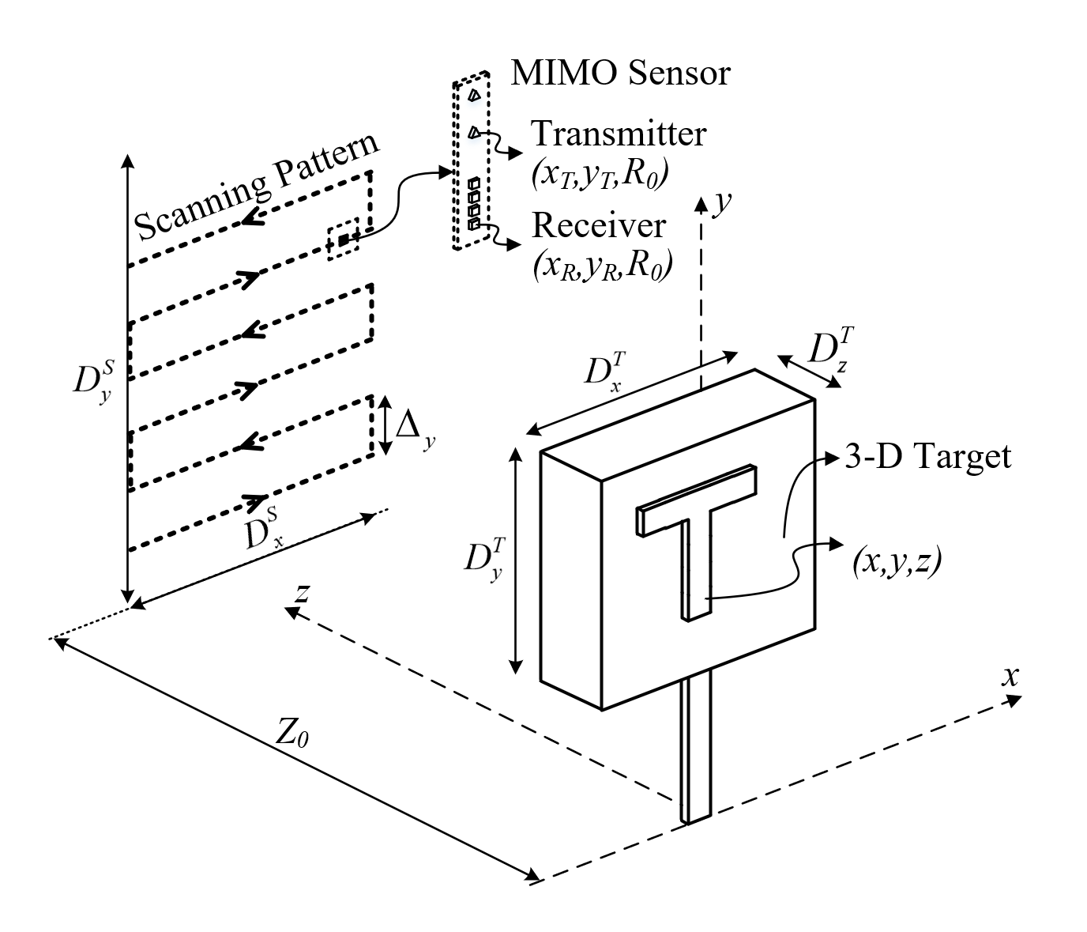
SAR Scenario
xWR1x43 radar using 8 virtual channels
Scanned in planar pattern
3-D target in the near-field
256 x 256 virtual synthetic aperture

Slide 3
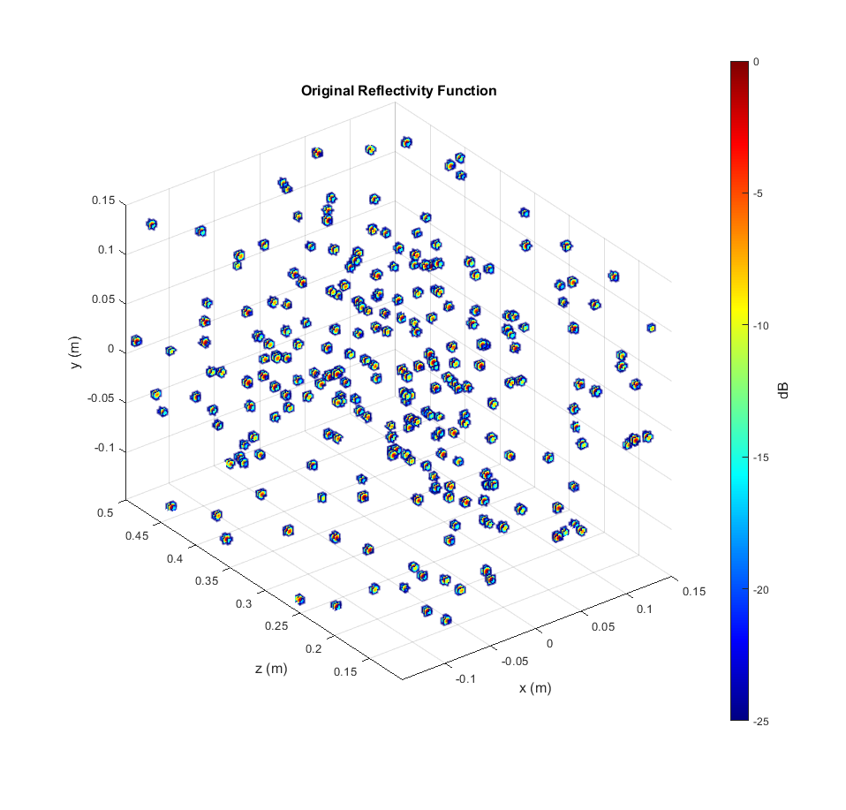
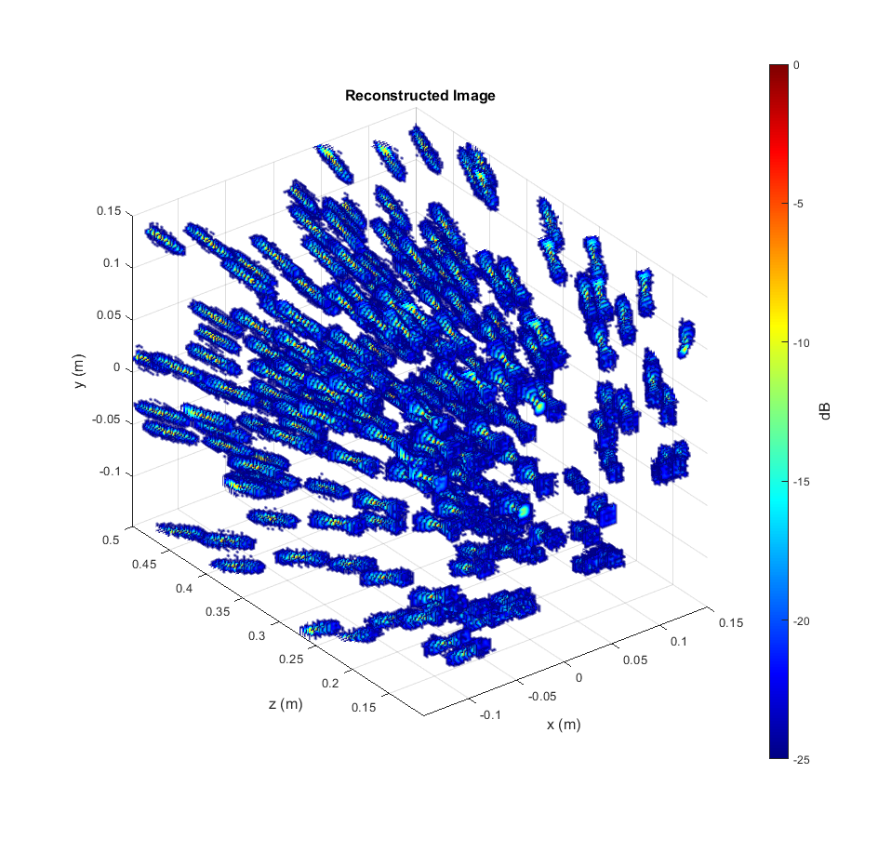
Results – Random Points

Slide 4

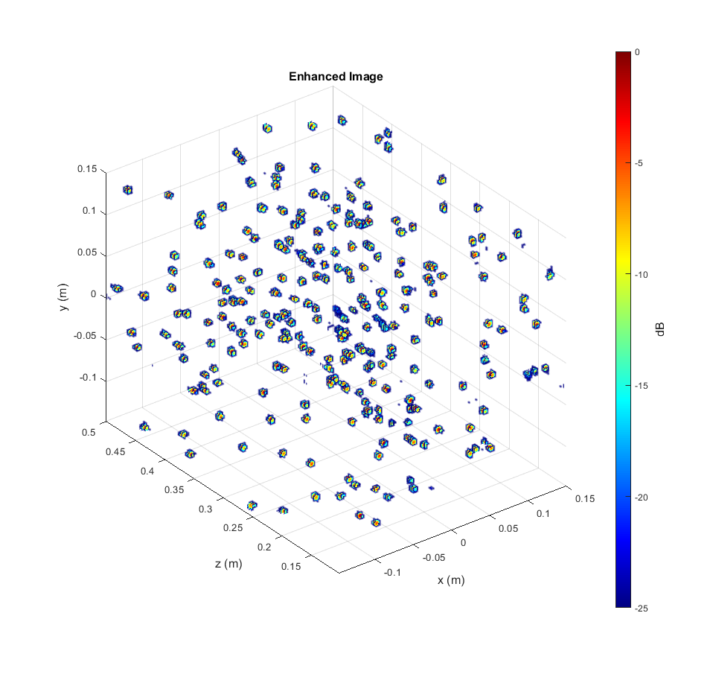
Results – Random Points
The algorithm has never seen these positions before, but knows the distortions introduced by the finite aperture and bandwidth

Slide 5
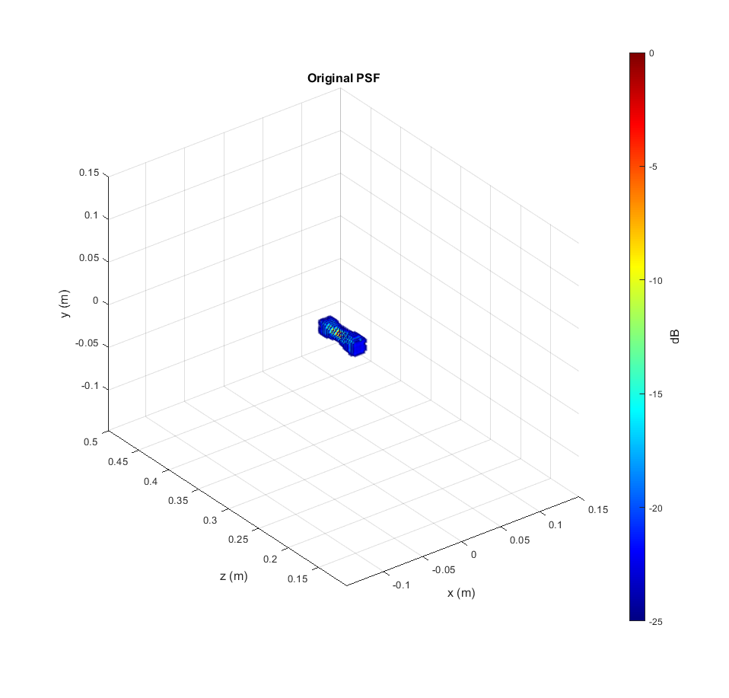
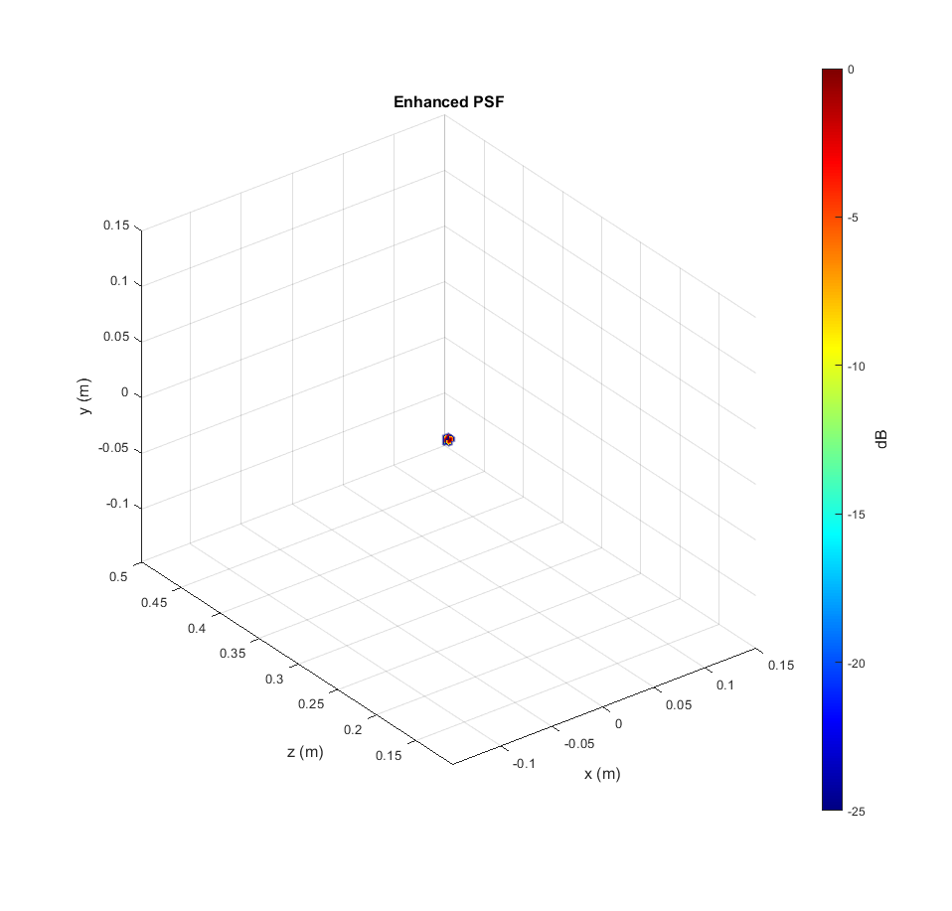
Results – PSF
FCNN can enhance the image and mitigate distortions in all three spatial dimensions
The algorithm has never seen these positions before, but knows the distortions introduced by the finite aperture and bandwidth

Slide 6
Results – PSF Comparison (linear)

Slide 7
Results – PSF Comparison (dB)

Slide 8
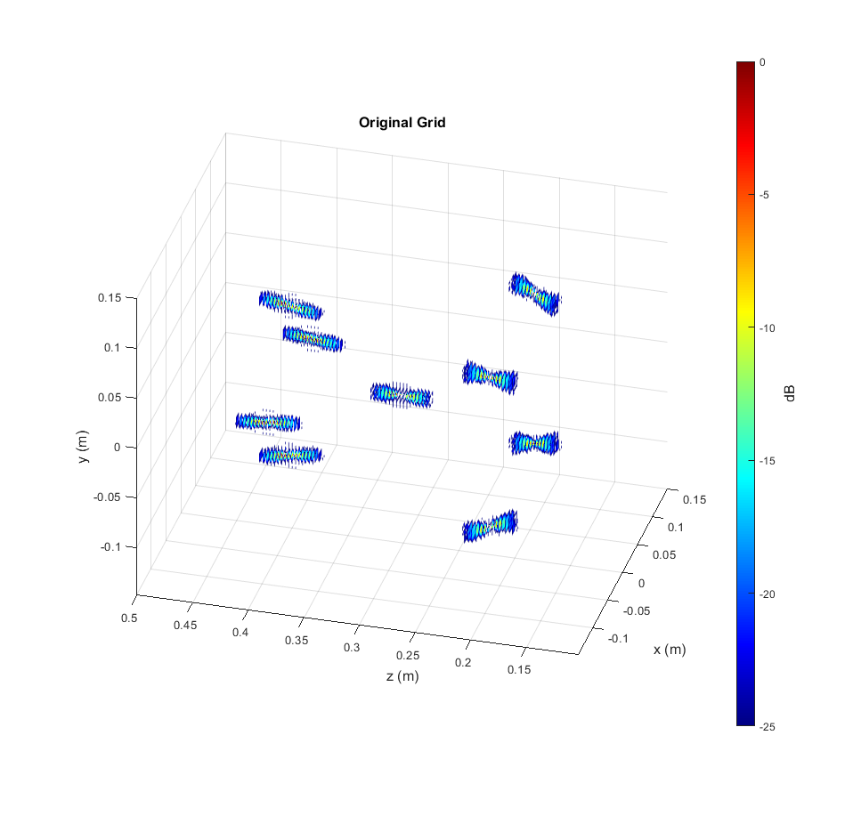
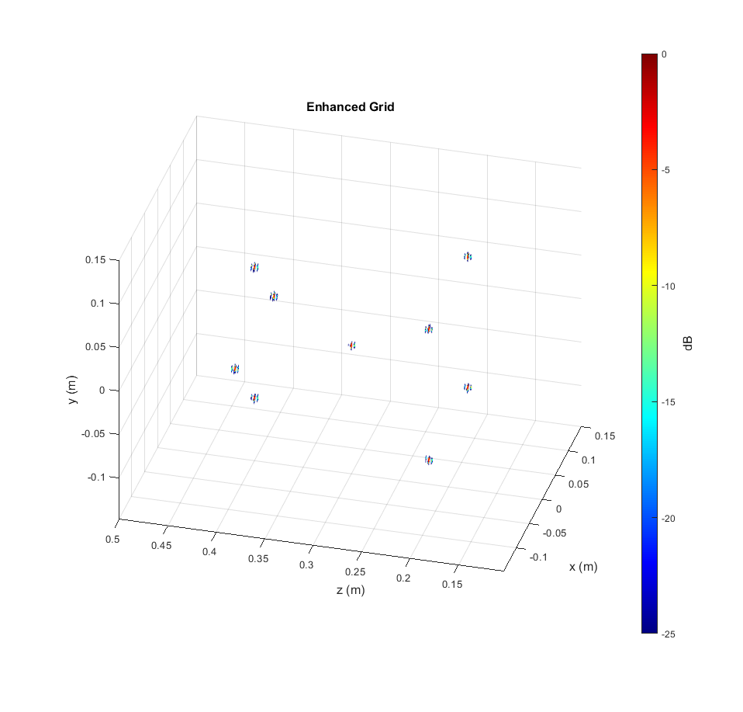
Results – Grid of Points
Notice distortion is spatially variant, but FCNN still remains robust
The algorithm has never seen these positions before, but knows the distortions introduced by the finite aperture and bandwidth

Slide 9
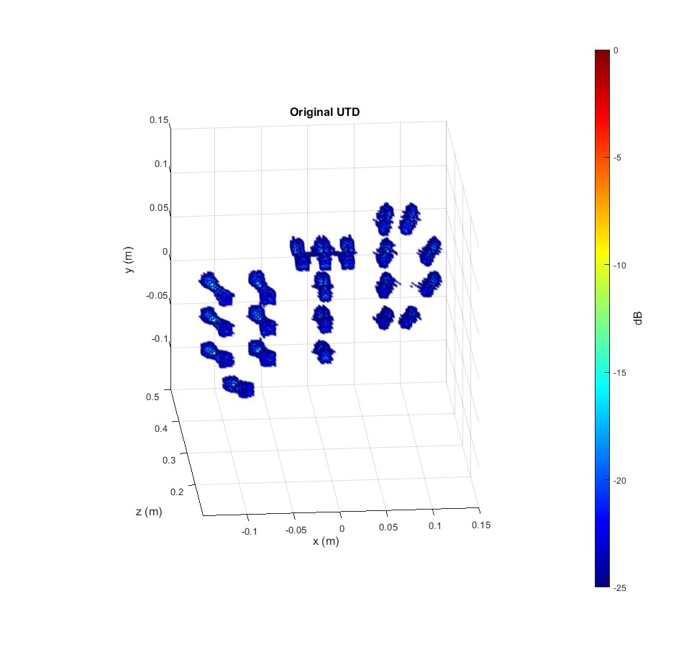
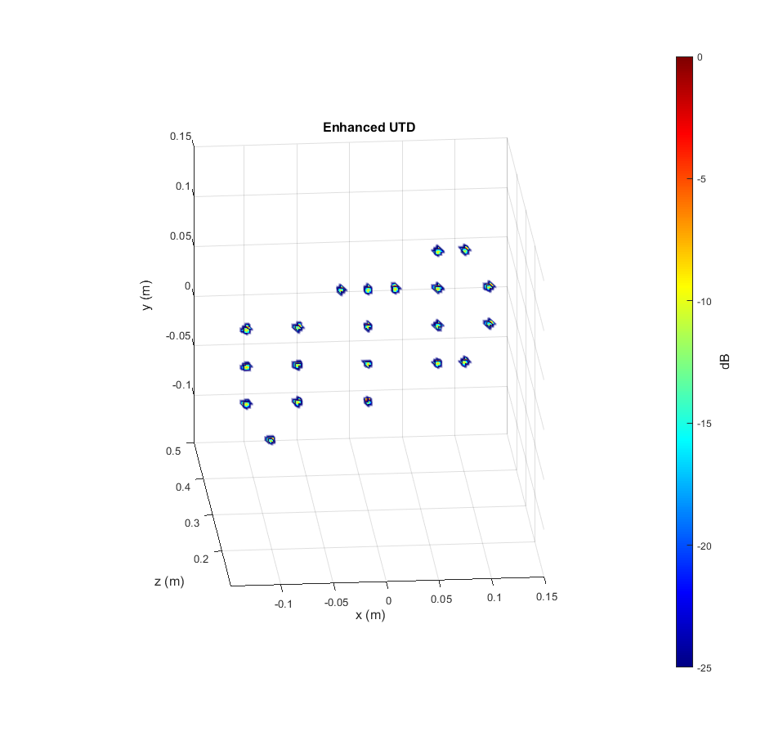
Results – UTD
The algorithm has never seen these positions before, but knows the distortions introduced by the finite aperture and bandwidth

Slide 10
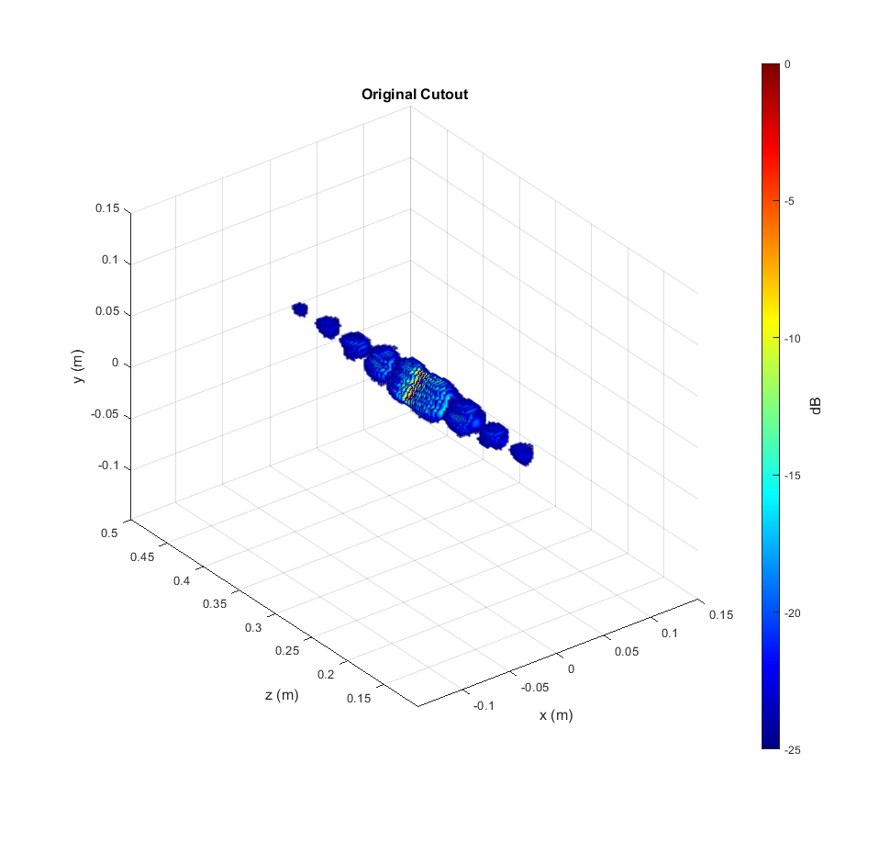
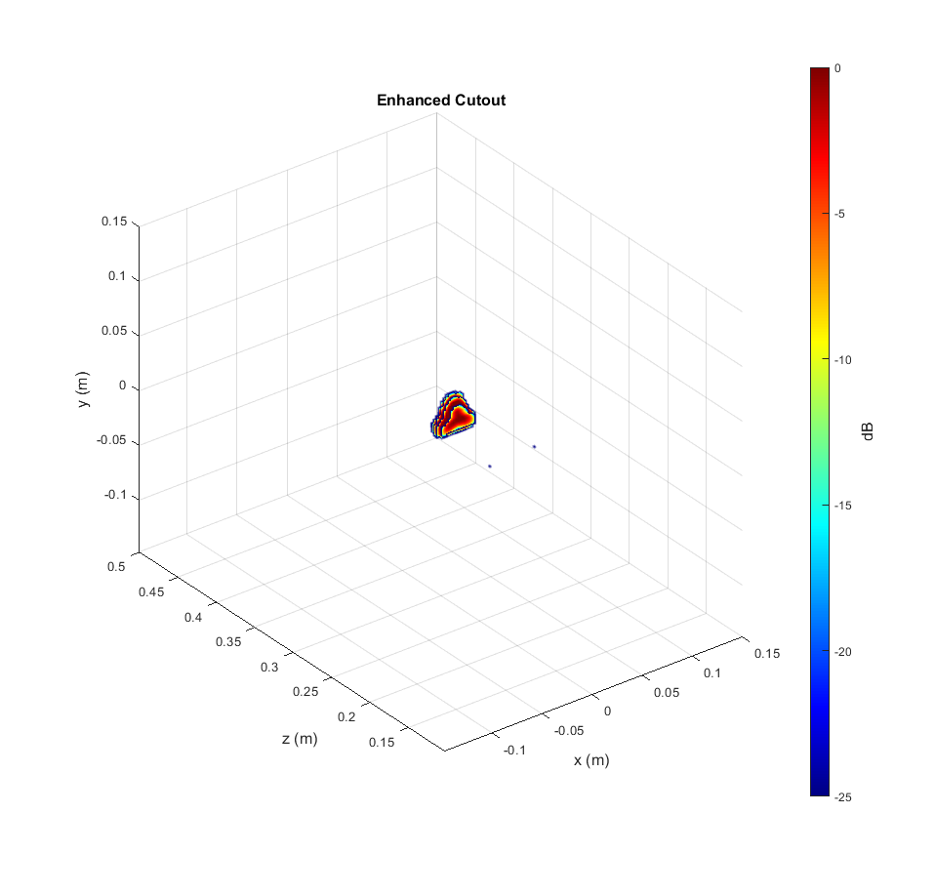
Results – Triangle Simulation

Slide 11
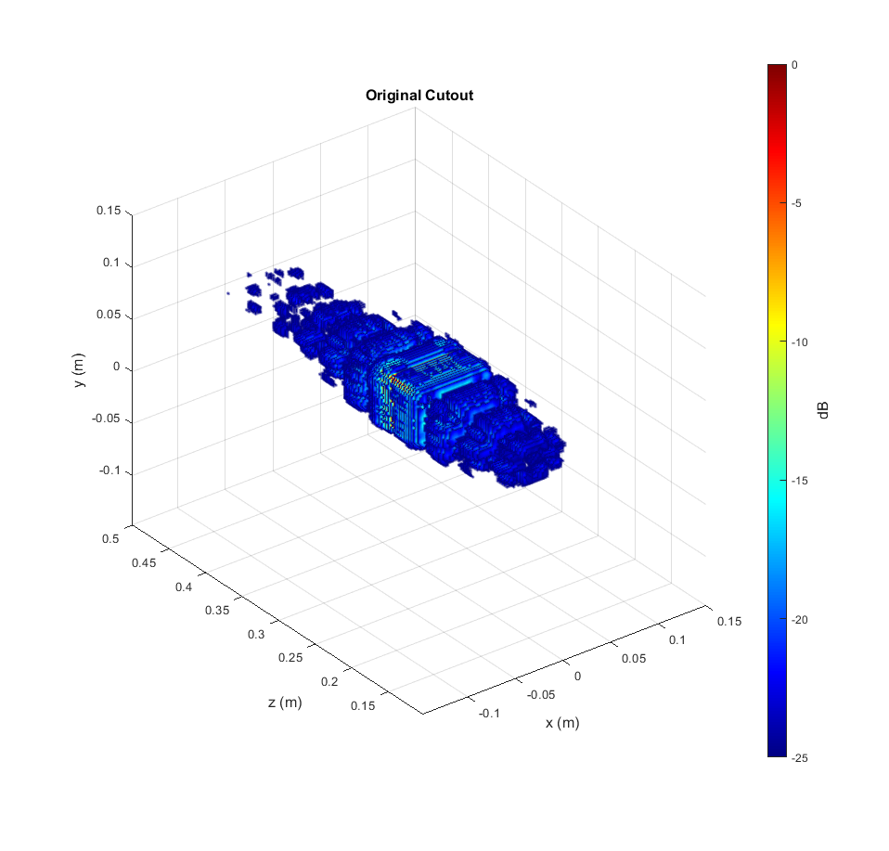
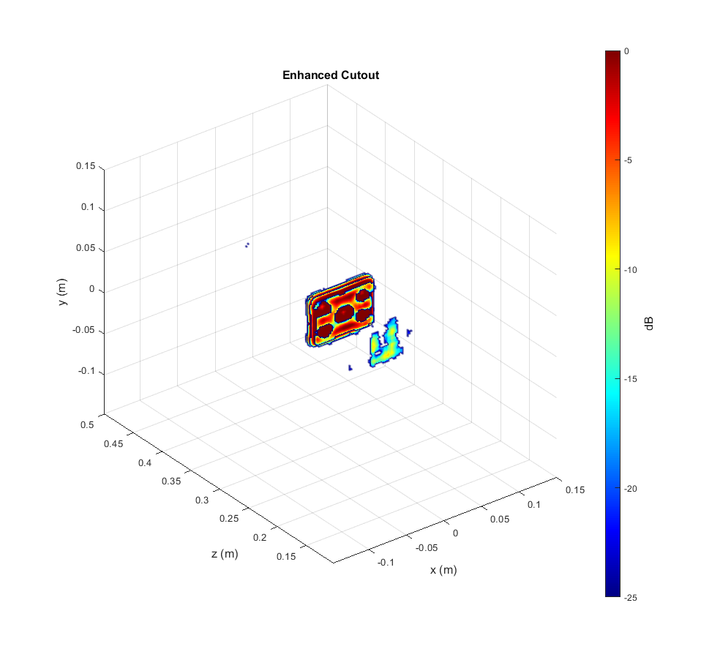

Results – Cutout Simulation (Needs Improvement)

Slide 12
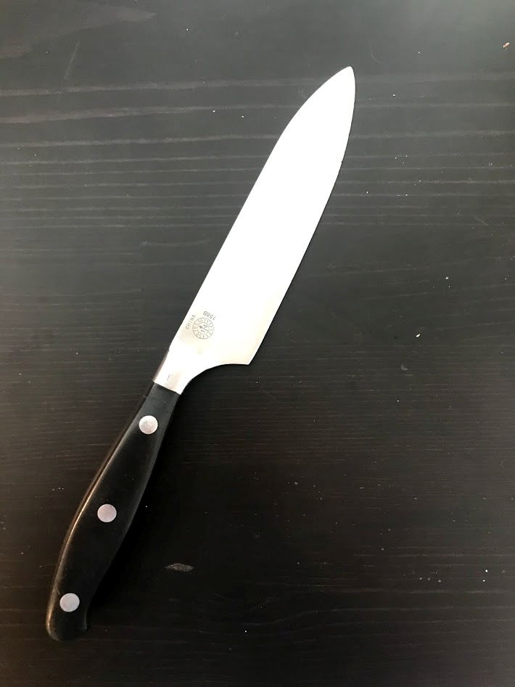
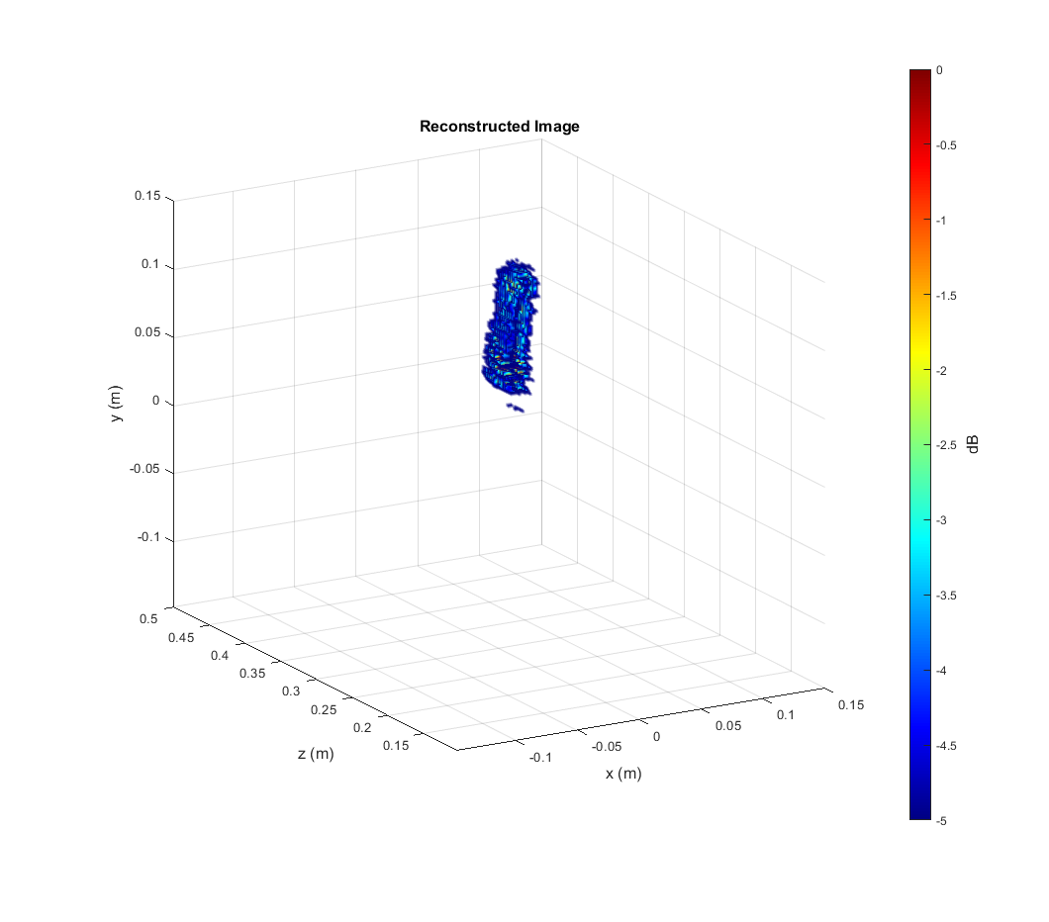
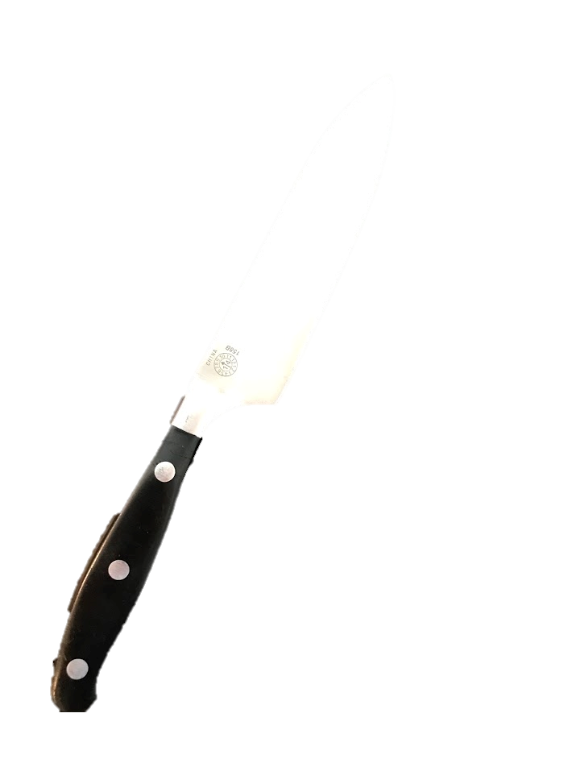
Results – Knife
Knife handle hidden behind PVC pipe holding the knife
Reconstructed image shows the knife blade

Slide 13
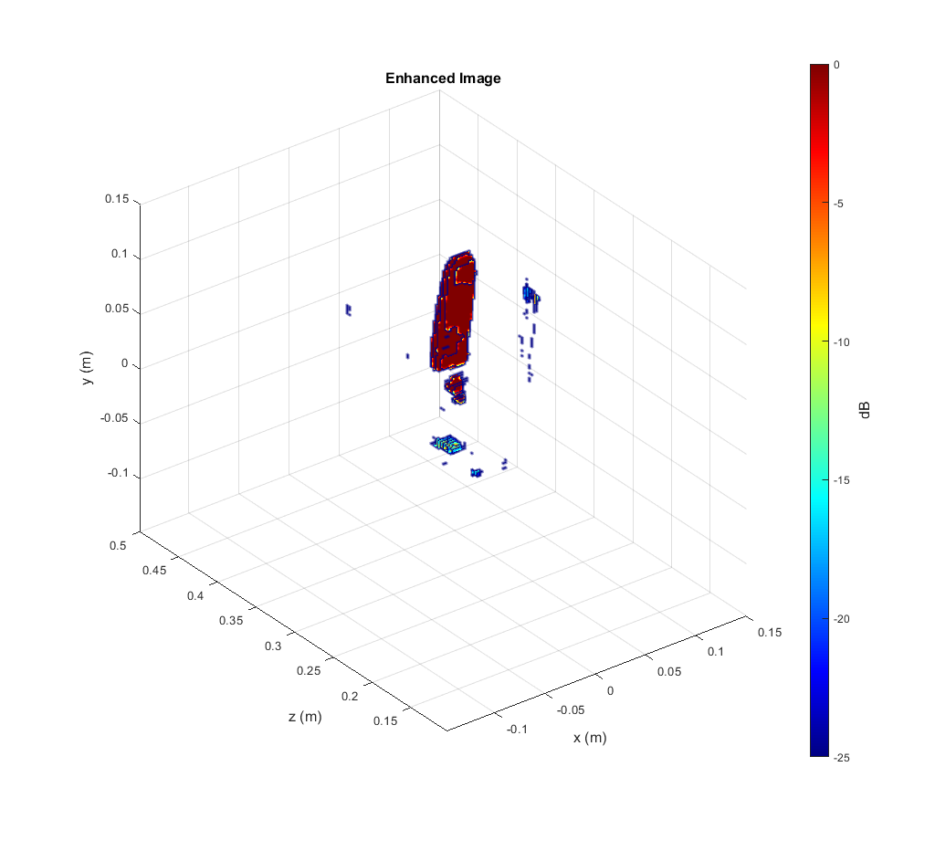
Results – Knife
Enhanced image emphasize blade shape, shows metal dots in handle, and removes noise (notice dynamic range is 25dB)
Original image roughly shows knife blade when dynamic range is limited to 5dB, but still shows strong ghosting in the range domain

